Slide 1
Exploring Most Popular Venues for Three Major Cities in Saudi Arabia

Slide 2
Exploring cities for most popular venues
The purpose of the exploration is to answer two main questions:
Where do people spend their time?
What are they looking for?
Those questions are critical as a starting point for someone who is interested in owning a business or investing in one.
One of the main goals under Saudi Arabia 2030 vision is to encourage and attract investors locally and globally to invest their money and start their business in it.
Riyadh, Jeddah and Dammam are three major cities that are reach with opportunities due to their location, population, and importance.

Slide 3
Data acquisition and cleaning
Venues and their related information such as category and location was obtained through Foursquare API.
The obtained data had missing and inconsistent values related to the city information, which was replaced by a single value either.
Extracting and keeping only related information.
Out of 22 features, only five were needed: Venue name, Category, Latitude, Longitude, and the City.

Slide 4
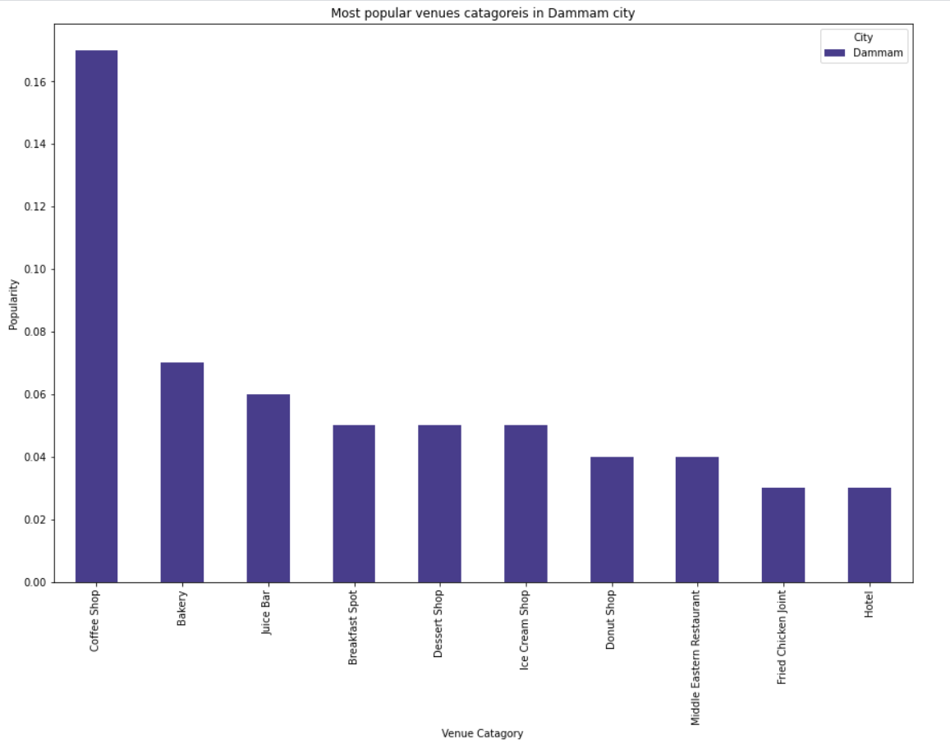
Popular places in Dammam

Slide 5
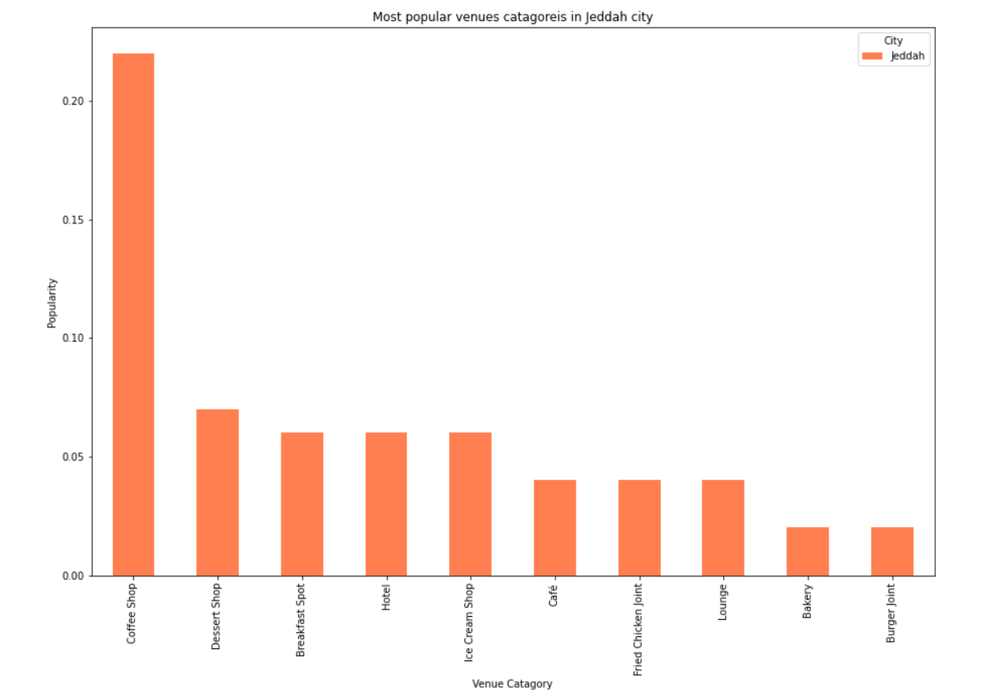
Popular places in Jeddah

Slide 6
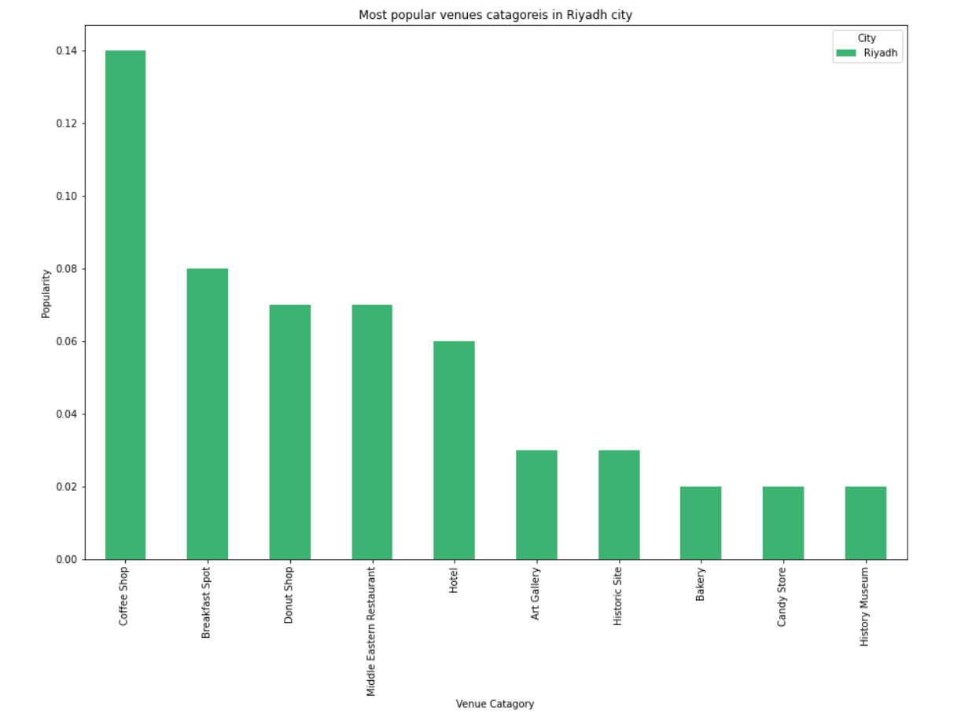
Popular places in Riyadh

Slide 7
Observations and findings
Coffee shops are the most popular across all three cities.
Riyadh has some unique categories that are among the top 10 popular places: historic sites, history museums, and art galleries. This can be a main contribution in having hotels as one of the top 5 popular venues.
Jeddah and Dammam are very similar due to having many common categories.
Previous charts shows that the most attractive city to stay in is Jeddah, and the lowest is Dammam. This is shown by looking at the Hotels ranks; forth in Jeddah, fifth in Riyadh, and tenth in Dammam.

